Slide 1
Research Experience 1
With Jin-Han Xie

Slide 2
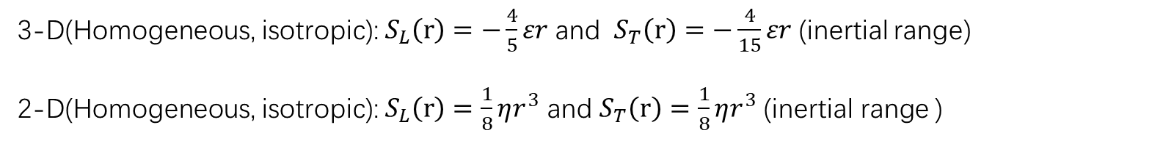
2-D turbulence
Unlike three-dimensional turbulence, two-dimensional turbulence lacks vortex stretching, resulting in many unusual behaviors. In three-dimensional turbulence, the famous Kolmogorov’s 4/5th inertial range law and the energy cascade phenomenon are well-known. By leveraging the conservation of energy and enstrophy in two-dimensional turbulence, we can derive the form of the energy spectrum within a certain range and the phenomenon of inverse energy cascade.
3-D(Homogeneous, isotropic):${ S}_{L}\left(r\right)=−\frac{4}{5}εr$ and ${ S}_{T}\left(r\right)=−\frac{4}{15}εr$ (inertial range)
2-D(Homogeneous, isotropic): $S_{L}\left(r\right)=\frac{1}{8}ηr^{3}$ and $S_{T}\left(r\right)=\frac{1}{8}ηr^{3}$ (inertial range )

Slide 3

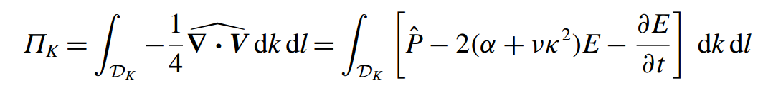
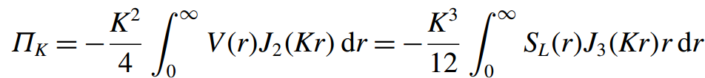
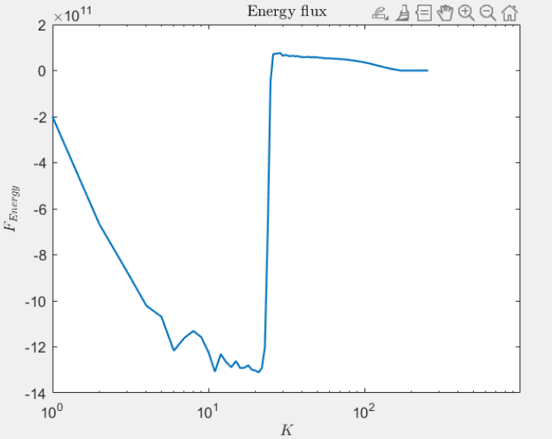

2-D turbulence
2-D turbulence spectral energy flux
$$Π_{k}<0 (inverse energy flux)$$

Slide 4
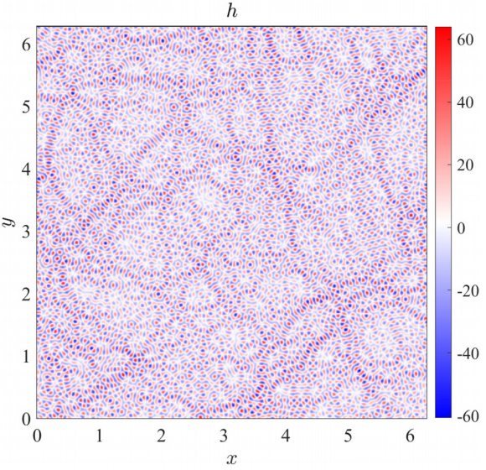
Topography
In two-dimensional turbulence, topography at different scales can have varying effects on the turbulence energy spectrum and the transfer of energy across scales.
An illustration of small-scale topography, $k_{h}=64$

Slide 5
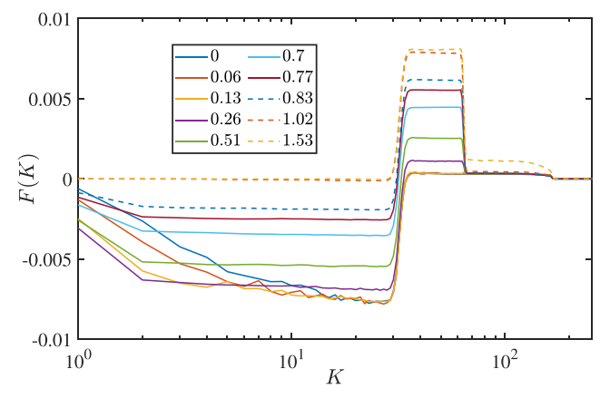
Topography
Topography at different scales and heights affects turbulence differently, and it is related to the dimensionless quantity 𝐾. We examine its influence on cross-scale energy transfer.
When 𝐾 is sufficiently large, a peculiar phenomenon occurs: the topography influences small scales but affects the cross-scale energy transfer to larger scales, allowing energy to be transferred to even larger scales before being dissipated.

Slide 6
My research
Currently, the research group has studied cases where the scale of the topography is smaller than the scale of the forces. Based on this, I will investigate cases where the scale of the topography is larger than the scale of the forces, observing whether it affects cross-scale energy transfer across both small and large scales, and further exploring the changes in physical characteristics such as the energy spectrum.
Due to my recent studies in environmental fluid mechanics and turbulence, my main work is being carried out this semester. I have already completed some numerical simulations, and I still need to summarize the results and conduct further analysis.

Slide 7
Reference
[1] Erik Lindborg, Can the atmospheric kinetic energy spectrum be explained by two-dimensional turbulence, J. Fluid Mech. (1999), vol. 388, pp. 259–288.
[2] Jin-Han Xie and Oliver Bühler, Exact third-order structure functions for two-dimensional turbulence, J. Fluid Mech. (2018), vol. 851, pp. 672–686.
[3] Lin-Fan Zhang and Jin-Han Xie, Spectral condensation and bidirectional energy transfer in quasi-geostrophic turbulence above small-scale topography, Phys. Fluids 36, 086601 (2024)
[4] Lennard Miller, Bruno Deremble, and Antoine Venaille, Gyre Turbulence: Anomalous Dissipation in a Two-Dimensional Ocean Model

